Slide 1
University of Illinois at Urbana-Champaign Dept. of Electrical and Computer Engineering ECE 220: Computer Systems & Programming
Arithmetic using Stack

Slide 2
Conventions Provide Implicit Information
What does this mean: 1 + 2 × 3 ?
It could mean (1 + 2) × 3 = 9 .
Or it could mean 1 + (2 × 3) = 7 .
Most (all?) cultures on Earth
choose this one
by convention.
Notes:
Mention that there’s nothing particularly BETTER about the second form. However, we can reduce the number of parentheses needed by agreeing to one meaning or the other, which IS a benefit.

Slide 3
Arithmetic with Trees is Unambiguous
We can
eliminate ambiguity
by using trees.
(1 + 2) × 3 1 + (2 × 3)
×
+
+
×
3
1
1
2
3
2
Notes:
Explain the tree structures.

Slide 4
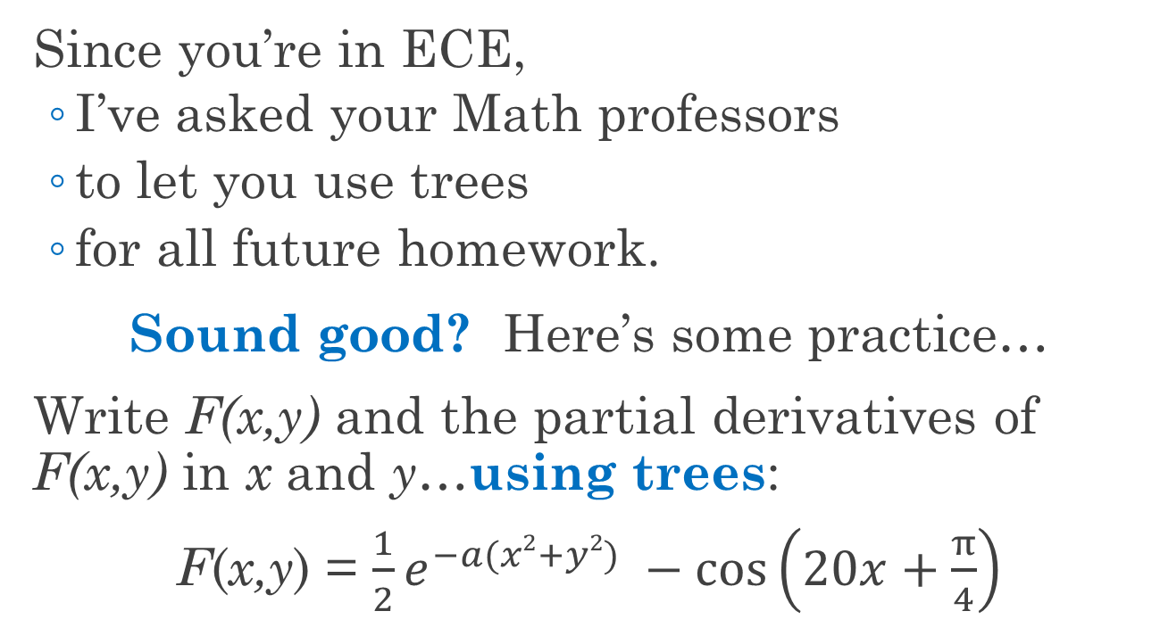
Why Not Always Use Trees?
Since you’re in ECE,
I’ve asked your Math professors
to let you use trees
for all future homework.
Sound good? Here’s some practice…
Write F(x,y) and the partial derivatives of F(x,y) in x and y…using trees:
F(x,y) = $\frac{1}{2}e^{−a(x2+y2)} −cos\left(20x+\frac{π}{4}\right)$
Trees are painful for humans!
Notes:
Not impossible or conceptually challenging, just a pain to use.

Slide 5
Other Notations are Also Unambiguous
Our usual notation (“1 + 2”)
is called infix because
operators appear in between operands.
Postfix (and prefix) notation
is not ambiguous,
So it does not require parentheses!
For 20+ years, all HP engineering calculators used postfix (“reverse Polish”)…ask your parents.
Notes:
Sad … they used to all have firsthand experience. The processors in those calculators were, of course, stack machines: low-power and simple.

Slide 6
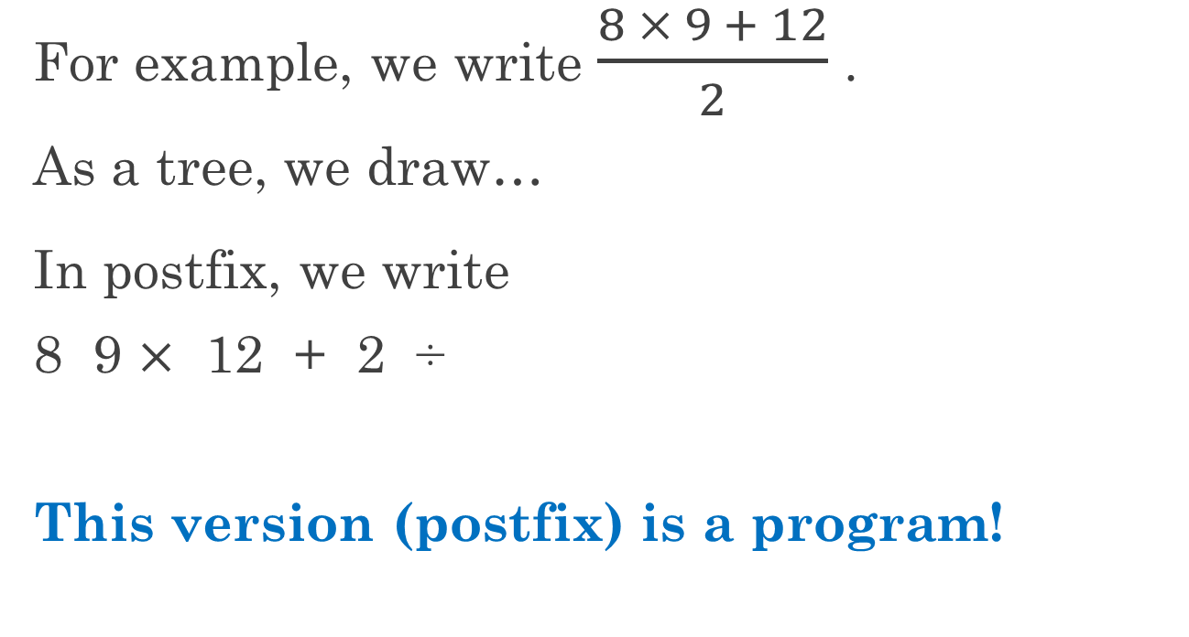
Postfix Notation is a Programming Language!
For example, we write $\frac{8 × 9 + 12}{2}$ .
As a tree, we draw…
In postfix, we write
8 9 $×$ 12 + 2 ÷
This version (postfix) is a program!
÷
+
2
×
12
8
9
Notes:
Ask them the answer for the first form. Make sure that the students see the equivalence for the other forms.

Slide 7
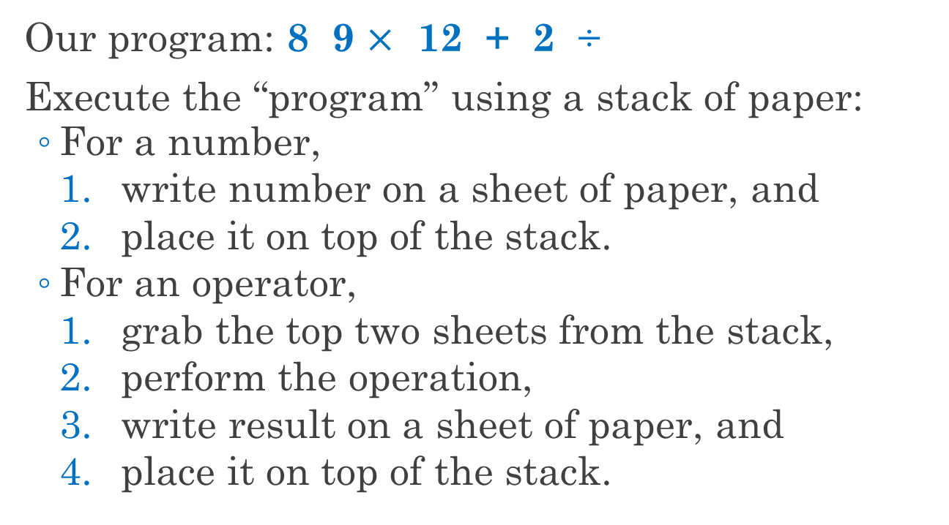
Let’s Run the Program…
Our program: 8 9 $×$ 12 + 2 ÷
Execute the “program” using a stack of paper:
For a number,
write number on a sheet of paper, and
place it on top of the stack.
For an operator,
grab the top two sheets from the stack,
perform the operation,
write result on a sheet of paper, and
place it on top of the stack.
Notes:
Use a table and paper and run the program. Really!

Slide 8
R6 Points to the Top of Our Stack in LC-3 Memory
To compute our postfix program, we used a stack of paper.
Can we use computer memory instead?
Do you remember the idea of
putting subroutine inputs/outputs
into memory, then
using a register
to point to those memory locations?
For LC-3, use R6 to point to the top of our stack.*
*A convention. Most ISAs have a register called the stack pointer.
Notes:
Make sure that the students get the idea: the stack pointer points to an address, and at/near that address are the bits of interest.

Slide 9
When R6 Points to Base of Stack, Stack is Empty
Initially,
R6 points to “base” of stack,
let’s say address x4000,
and the stack is empty.
What is in memory above the top of the stack? Hint: not “air,” nor “blanks.”
By convention, those bits are NOT on the stack.
...
x3FFD
x3FFF
x3FFE
Bits!
x3FFF
R6→
x4000
Notes:
Use a table and paper and run the program. Really!

Slide 10
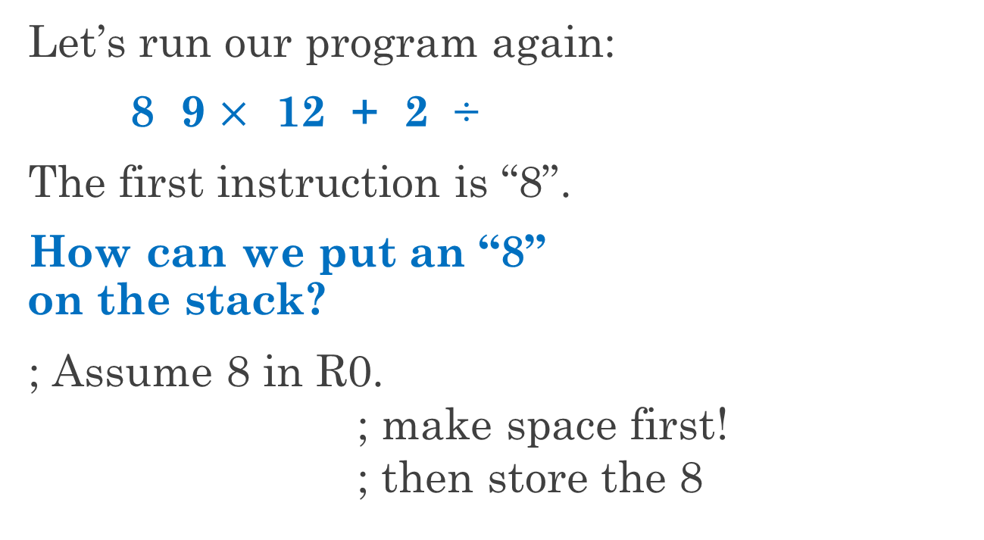
To “Execute” a Number Instruction, Push Onto Stack
Let’s run our program again:
8 9 $×$ 12 + 2 ÷
The first instruction is “8”.
How can we put an “8” on the stack?
; Assume 8 in R0.
; make space first!
; then store the 8
...
x3FFD
x3FFF
x3FFE
R6→
#8
x3FFF
R6→
x4000
ADD R6,R6,#-1
called a “push”
STR R0,R6,#0
Notes:
Point out that, after the first instruction, the space is on the stack. If one swaps the instructions, the code writes into memory not on the stack, which can lead to problems. (For example, an interrupt may use the stack and clobber the values above the top of stack.)

Slide 11
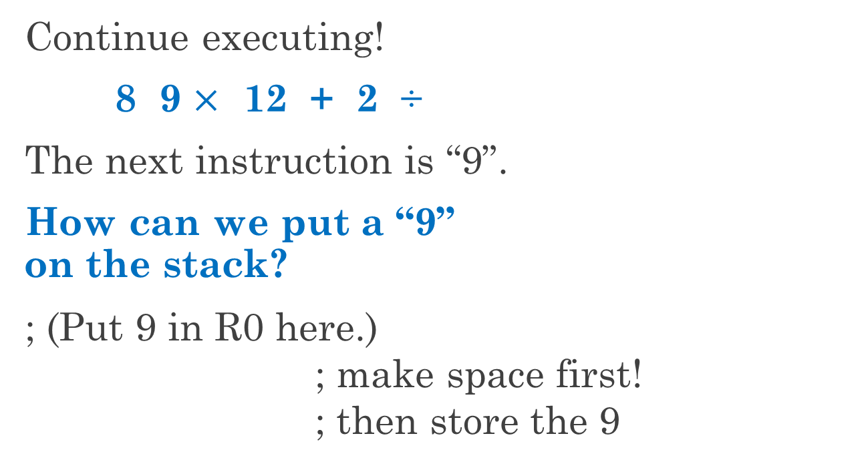
Pushing R0 Always Uses the Same Two Instructions
Continue executing!
8 9 $×$ 12 + 2 ÷
The next instruction is “9”.
How can we put a “9” on the stack?
; (Put 9 in R0 here.)
; make space first!
; then store the 9
...
x3FFD
x3FFF
R6→
#9
x3FFE
R6→
#8
x3FFF
x4000
ADD R6,R6,#-1
same two
inst.!
STR R0,R6,#0
Notes:
Same comments as last slide: push means make space, then store.

Slide 12
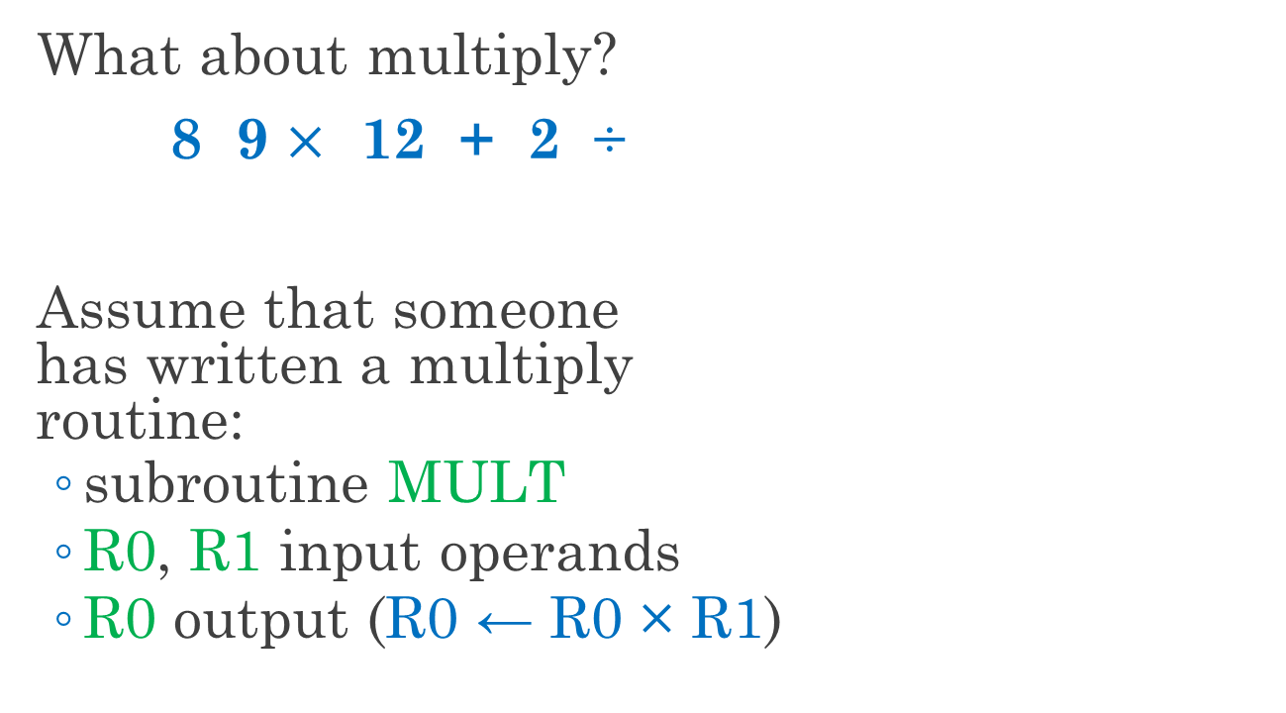
The Next Instruction is Multiply
What about multiply?
8 9 $×$ 12 + 2 ÷
Assume that someone has written a multiply routine:
subroutine MULT
R0, R1 input operands
R0 output (R0 ← R0 × R1)
...
x3FFD
x3FFF
R6→
#9
x3FFE
#8
x3FFF
x4000
Notes:
Same comments as last slide: push means make space, then store.

Slide 13
Example of a MULT Subroutine
MULT
AND R2,R2,#0
ADD R1,R1,#0
BRz MULTDONE
MULTLOOP
ADD R2,R2,R0
ADD R1,R1,#-1
BRnp MULTLOOP
MULTDONE
ADD R0,R2,#0
RET
What is the call interface for this subroutine?
Inputs: R0, R1
Output: R0 ← R0 × R1
Caller-saved:
R1, R2, R7
Callee-saved: R3, R4, R5, R6
Notes:
The check for zero is not necessary, since adding anything to itself 2^16 times produces 0.
Students may not realize that this approach works (perhaps slowly) for negative numbers.
Remind them that addition is correct mod 2^16, so, for example, if R1=-1,
(R0 + … + R0 = 65535 R0 = 65536 R0 – R0 = -R0) mod 2^16.
Outputs (R0) are implicitly caller-saved, of course.

Slide 14
To Multiply: Pop Twice, Multiply, Push Product
STACKMULT
; pop 9 into R1
; remove space
LDR R1,R6,#0
...
ADD R6,R6,#1
x3FFD
x3FFF
Is the “9” still in memory?
R6→
#9
x3FFE
R6→
#8
x3FFF
x4000
Probably, but it’s NOT on the stack.
Notes:
Point out that the order of POP is the opposite of PUSH: read the value, then remove the space from the top of the stack.

Slide 15
To Multiply: Pop Twice, Multiply, Push Product
STACKMULT
LDR R1,R6,#0 ; pop 9 into R1
ADD R6,R6,#1 ; remove space
; pop 8 into R0
; remove space
...
x3FFD
LDR R0,R6,#0
x3FFF
ADD R6,R6,#1
#9
x3FFE
R6→
#8
x3FFF
R6→
x4000
Notes:
Same comments as last slide: push means read value, then remove space.

Slide 16
To Multiply: Pop Twice, Multiply, Push Product
STACKMULT
LDR R1,R6,#0 ; pop 9 into R1
ADD R6,R6,#1 ; remove space
LDR R0,R6,#0 ; pop 8 into R0
ADD R6,R6,#1 ; remove space
; R0 is 72
...
x3FFD
x3FFF
#9
x3FFE
JSR MULT
#8
x3FFF
R6→
x4000
We’re ready to call MULT!
Note that the stack is empty.
Notes:
Inputs are in the correct registers, so just call the subroutine. The stack being empty is not related to the call, but be sure that the students understand the symbolism: there is nothing on the stack, but there are still bits in the memory.

Slide 17
To Multiply: Pop Twice, Multiply, Push Product
STACKMULT
LDR R1,R6,#0 ; pop 9 into R1
ADD R6,R6,#1 ; remove space
LDR R0,R6,#0 ; pop 8 into R0
ADD R6,R6,#1 ; remove space
JSR MULT ; R0 is 72
; push R0
...
x3FFD
x3FFF
#9
x3FFE
R6→
#72
x3FFF
#8
ADD R6,R6,#-1
R6→
x4000
STR R0,R6,#0
Use the same instructions as before!
That’s it!
Notes:
As before, push means make space, then store.

Slide 18
Subroutine Can Mean More than Just Adding RET
STACKMULT
LDR R1,R6,#0 ; pop 9 into R1
ADD R6,R6,#1 ; remove space
LDR R0,R6,#0 ; pop 8 into R0
ADD R6,R6,#1 ; remove space
JSR MULT ; R0 is 72
ADD R6,R6,#-1 ; push R0
STR R0,R6,#0
But what if we want a subroutine?
RET
Good enough?
NO!
Notes:
Let the students answer and mention R7 needing to be saved. Then move on to illustrate.

Slide 19
A Subroutine that Uses JSR or TRAP Must Protect R7
STACKMULT
LDR R1,R6,#0 ; pop 9 into R1
ADD R6,R6,#1 ; remove space
LDR R0,R6,#0 ; pop 8 into R0
ADD R6,R6,#1 ; remove space
JSR MULT ; R0 is 72
ADD R6,R6,#-1 ; push R0
STR R0,R6,#0
RET
; R7 has the return address here.
Where does R7 point after JSR?
Here.
So RET creates a loop…
Notes:
Eventually the loop will overwrite the code…

Slide 20
Add a Space with a Label, then Save and Restore R7
STACKMULT
; save R7
LDR R1,R6,#0 ; pop 9 into R1
ADD R6,R6,#1 ; remove space
LDR R0,R6,#0 ; pop 8 into R0
ADD R6,R6,#1 ; remove space
JSR MULT ; R0 is 72
ADD R6,R6,#-1 ; push R0
STR R0,R6,#0
; restore R7
RET
; space for R7
ST R7,SM_R7
Now the subroutine is complete.
LD R7,SM_R7
SM_R7 .BLKW #1

Slide 21
What is a Think-Pair-Share?
A group exercise in lecture, not unlike discussion sections in ECE120.
The process:
I give you a problem.
You form groups of 3-4 people.
Talk about ways to solve the problem.
Once enough of the groups have finished, one group volunteers to share their answer.
We go over the group’s answer together.
Notes:
First use of this kind of problem in 220, so need to make sure they understand the process.

Slide 22
The Task: a Factorial Subroutine
Write subroutine FACTORIAL
to compute output R0
as the factorial of input R0.
In other words, R0 ← 1 × 2 × … × R0.
Assumptions and rules…
Assume that input R0 is at least 1.
Assume that R6 points to a valid stack.
Write your subroutine in LC-3 assembly language.
Use the STACKMULT subroutine to calculate the answer.
Clearly define the calling interface.

Slide 23
A Task on Your Own: 16-bit Palindrome Check
What’s a palindrome?
Same spelling backwards as forwards.
Examples include “Otto” and “Hannah.”
Your task:
Check whether R0 is a palindrome.
Example: 0111 1011 1101 1110.
Return R0=1 if yes, R0=0 if no.
Assumptions and rules…
Assume that R6 points to a valid stack (use it).
Write your code in LC-3 assembly language.
See sample solution on the web page.

Slide 24
We Can Use Known Values on the Stack Directly
In practice, we need not strictly obey the rules of the stack abstraction.
Consider the following task:
sum three non-negative values from top of the stack,
pop all three values, and
return the sum in R0.
Let’s assume that only R0 should change.
R6→
v1
v2
v3
...
base
Notes:
Ask the students whether they can use an LC-3 instruction to read v2 or v3 (LDR with base R6 and offset #1 or #2, respectively).

Slide 25
Let’s Start by Saving R1 and Reading v1
SUM_OF_3
ST R1,SAVE_R1 ; save R1
LDR R0,R6,#0 ; R0 ← v1
SAVE_R1 .BLKW #1
R6→
v1
v2
So far, so good?
v3
But we’re not going to pop v1…
...
base
Make a space down here.

Slide 26
Load v2 Using LDR from M[R6 + 1]
SUM_OF_3
ST R1,SAVE_R1 ; save R1
LDR R0,R6,#0 ; R0 ← v1
LDR R1,R6,#1 ; R1 ← v2
ADD R0,R0,R1 ; R0 ← v1 + v2
SAVE_R1 .BLKW #1
R6→
v1
v2
v3
Read v2 before popping v1.
...
base
And find the sum…
Notes:
Use a table and paper and run the program. Really!

Slide 27
Do the Same for v3 (with Offset 2)
SUM_OF_3
ST R1,SAVE_R1 ; save R1
LDR R0,R6,#0 ; R0 ← v1
LDR R1,R6,#1 ; R1 ← v2
ADD R0,R0,R1 ; R0 ← v1 + v2
LDR R1,R6,#2 ; R1 ← v3
ADD R0,R0,R1 ; R0 ← v1 + v2 + v3
SAVE_R1 .BLKW #1
R6→
v1
v2
v3
...
base
Now read v3.
And find the sum…
Notes:
Use a table and paper and run the program. Really!

Slide 28
Pop All Three Values at Once
SUM_OF_3
ST R1,SAVE_R1 ; save R1
LDR R0,R6,#0 ; R0 ← v1
LDR R1,R6,#1 ; R1 ← v2
ADD R0,R0,R1 ; R0 ← v1 + v2
LDR R1,R6,#2 ; R1 ← v3
ADD R0,R0,R1 ; R0 ← v1 + v2 + v3
ADD R6,R6,#3 ; pop all three
SAVE_R1 .BLKW #1
R6→
v1
v2
v3
R6→
...
base
Done with the values: pop all three!
Notes:
Use a table and paper and run the program. Really!

Slide 29
Finish by Restoring R1 and Returning
SUM_OF_3
ST R1,SAVE_R1 ; save R1
LDR R0,R6,#0 ; R0 ← v1
LDR R1,R6,#1 ; R1 ← v2
ADD R0,R0,R1 ; R0 ← v1 + v2
LDR R1,R6,#2 ; R1 ← v3
ADD R0,R0,R1 ; R0 ← v1 + v2 + v3
ADD R6,R6,#3 ; pop all three
LD R1,SAVE_R1 ; restore R1
RET
SAVE_R1 .BLKW #1
v1
v2
v3
R6→
...
base
Restore R1 and return.

Slide 30
Breaking the Abstraction Can Be Done Safely
To use SUM_OF_3,
push three values, call SUM_OF_3, and use the result in R0.
Or allocate three locations with one ADD, write in three values, then call …
We can safely use
any data on the stack
if we know that it’s there.
Notes:
To be clear, we can also break the abstraction when we call the function by making three spaces with a single ADD and the using three STR instructions to fill the three spaces.
Students need to understand this idea to be ready for stack frames.

Slide 31
Can We Generalize SUM_OF_3 to SUM_OF_N?
The picture to the right shows
an array of three integers
on top of the stack.
What if we want to generalize?
Can we write a subroutine
that adds a variable number of non-negative numbers
from an array on top of the stack?
R6→
v1
v2
v3
...
base

Slide 32
Can We Generalize SUM_OF_3 to SUM_OF_N?
Can we write a subroutine that adds N non-negative numbers from the top of the stack?
Yes!
But the subroutine must know the value of N.
R6→
v1
...
vN
...
base

Slide 33
How Can the Subroutine Be Given N?
How can the caller tell the subroutine the value of N?
Hint: this is NOT a trick question. Give the easy answers first!
Use a fixed value, such as 3.
Pass N in a register, say R2.
R6→
v1
...
vN
...
base
Notes:
Encourage the students to get these answers first. First question: how did we know N in SUM_OF_3? We agreed in advance: N=3.
Second question: how do we normally pass information into a subroutine?

Slide 34
The Answers Will Be Useful in Other Contexts
This question occurs in many contexts:
determining array length
passing variable numbers of arguments, and
using network connections in applications.
Be sure that you understand the options!
Notes:
C functions allow variable number of arguments, and only one of the four options is viable in that case (passing the number on top of the stack, as with the format string in printf).
TCP connections are continuous streams of bytes, so applications have to re-build framing in order to be able to interpret the stream.

Slide 35
Another Solution: the ASCII String Approach
How can the caller tell the subroutine the value of N?
Use a fixed value, such as 3.
Pass N in a register, say R2.
How do ASCII strings work?
End the list with a non-data sentinel (such as -1).*
*Now you know why we assumed “non-negative.”
R6→
v1
...
vN
-1
...
base

Slide 36
Does Putting N at the End of the Array Work?
What if we put N at the end of the array?
Does such an approach work?
R6→
v1
...
vN
N
...
base
Notes:
Let the students think about it.

Slide 37
Does Putting N at the End of the Array Work?
Given the stack shown here, what should the subroutine return?
13? (N=2)
23? (N=4)
Something else? (Is N shown?)
The answer is ambiguous!
(Such an approach is not acceptable.)
R6→
10
3
2
8
4
…
base
Notes:
Again, let them think and maybe even answer before revealing the possible answer list.

Slide 38
One Other Solution is Possible
R6→
N
How can the caller tell the subroutine the value of N?
Use a fixed value, such as 3.
Pass N in a register, say R2.
End the list with a non-data sentinel (such as -1).
But there is one more answer…
Put N on top of the stack (always in a known position: M[R6]).
R6→
v1
...
vN
...
base
Notes:
Let the students figure it out if possible.

Slide 39
A Stack for MP3
In MP3,
you will use a stack
to implement a depth-first search (DFS).
Given
a list of extra events,
each with several options for hour slot,
you must try to find a combination
that works without schedule conflicts.

Slide 40
A Stack Frame Holds All Information for a Subroutine
Imagine that you are using
an ISA with few/no registers, so
you must use the stack to manage subroutine calls.
Let’s define a block of data
called a stack frame (or activation record)
that holds all of the information
needed for one subroutine.

Slide 41
A Stack Frame Holds All Information for a Subroutine
What needs to be in a stack frame?
Local variables
Address of caller’s stack frame
Return address (R7 in LC-3)
Outputs (return value)
Inputs (parameters, arguments)
You’ll grow quite tired of these by March.
these form the linkage
Notes:
Order is a guess at what students might say. Last three are the linkage.
Lots of stack frames ahead…

